Slide 1
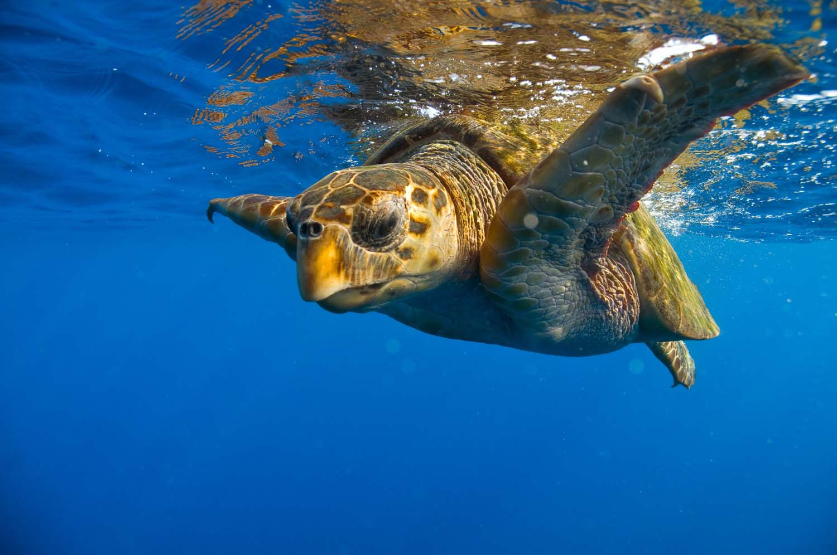


With the turtles in the sea
Photo: Marta Granville

Slide 2
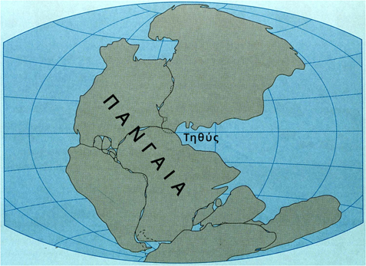

Once, there was only one land, Pangaea.
Tethys, was the ancestor of the Mediterranean sea (250 million years ago)
https://paleo-opolis.com/2014/10/24/pangaea/

Slide 3
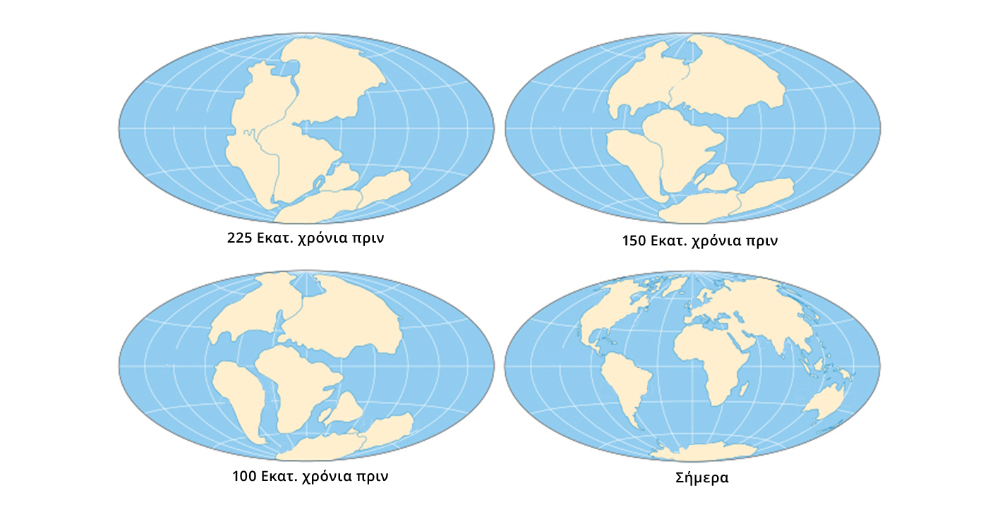
The Land was divided and the Continents changed position...
225 million years ago
150 million years ago
...The Continents separated the seas, along with the turtles living there.
Encyclopedia Britannica
100 Million years ago
Today

Slide 4
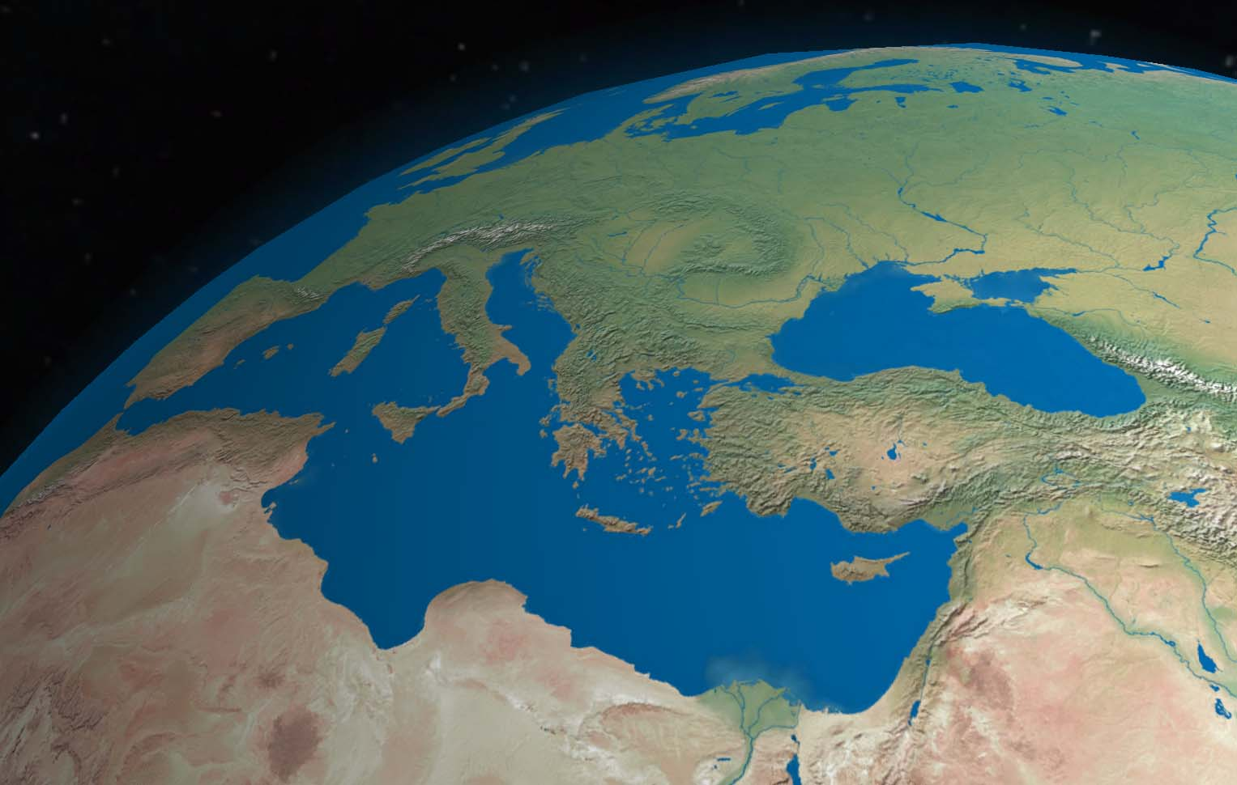
Today: the Mediterranean is the only sea located between three continents.
Μεσόγειος, σήμερα: η μόνη θάλασσα ανάμεσα σε 3 ηπείρους
Photo: NASA/Goddard Space Flight Center

Slide 5
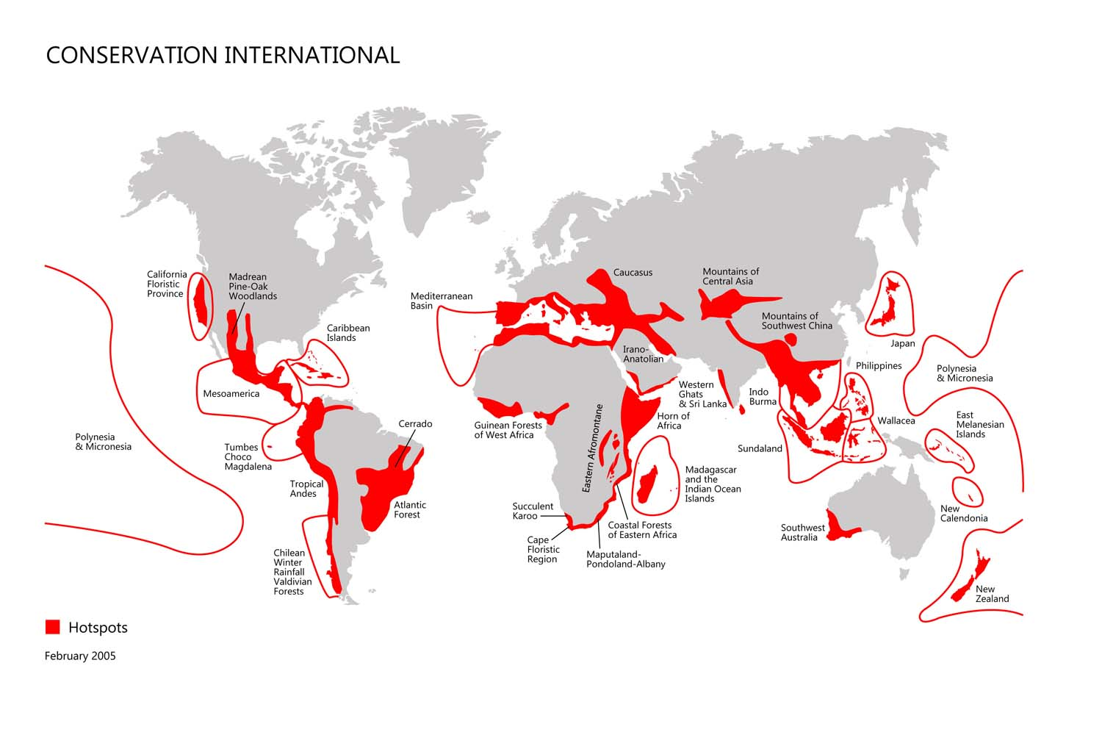
The Mediterranean Basin is one of the global biodiversity hotspots
Η Μεσόγειος είναι ένα από τα παγκόσμια κέντρα βιοποικιλότητας. (γιατί;)
Map from Conservation International

Slide 6
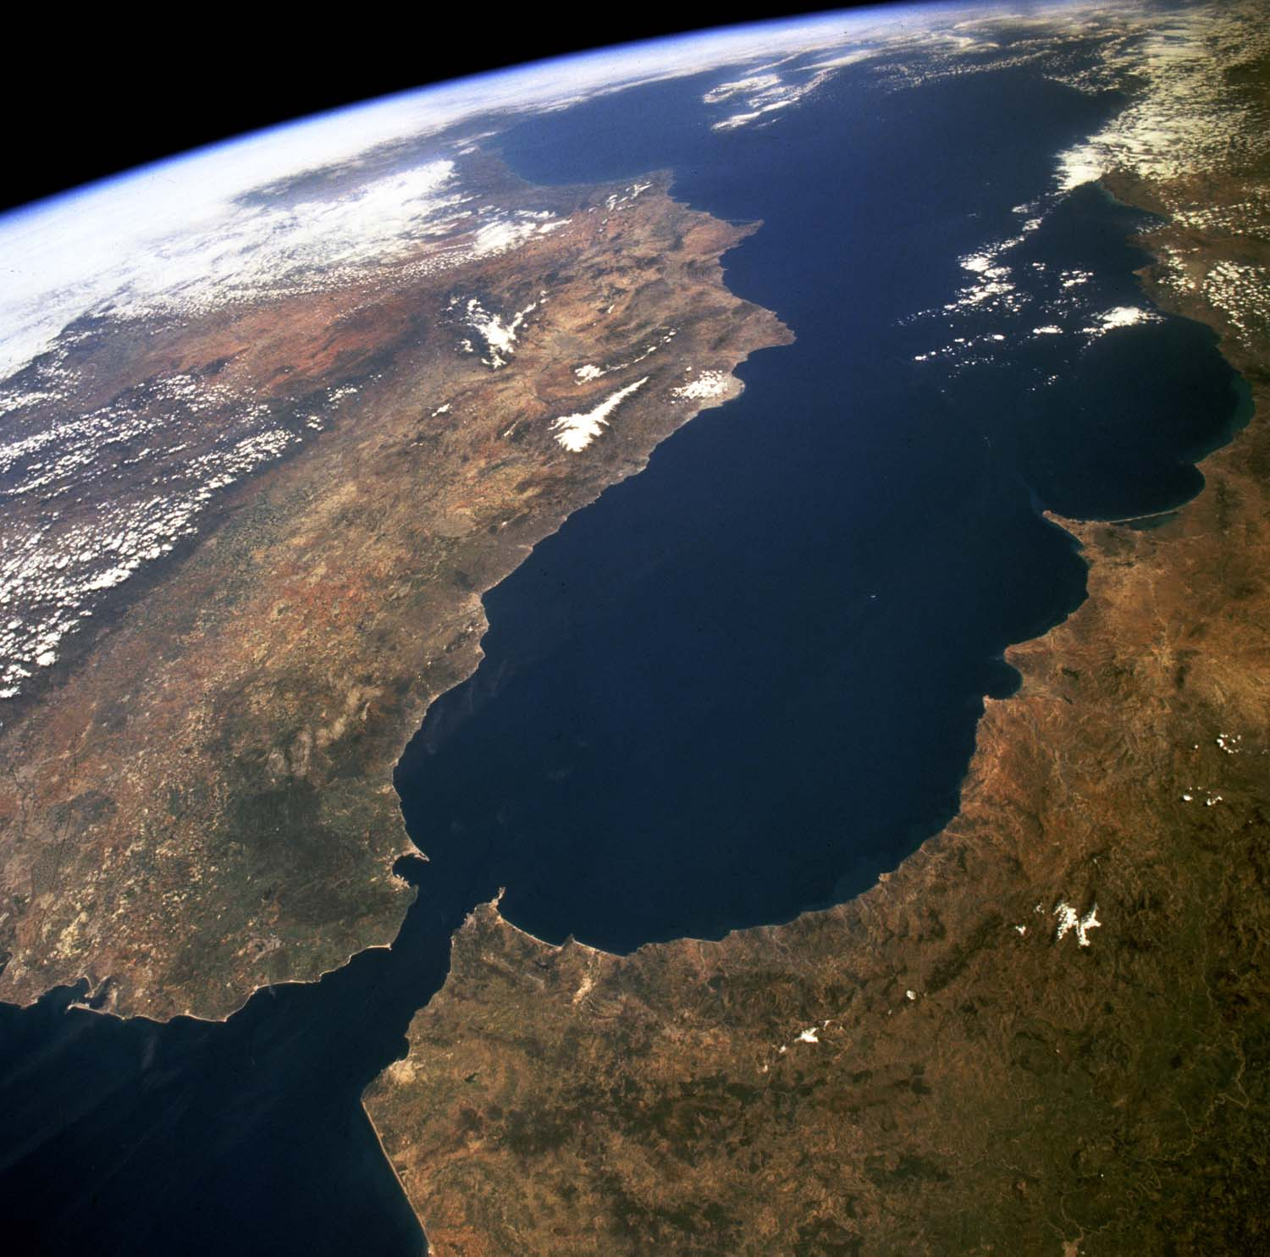
It also welcomes water, plants and animals from neighboring seas
Τροφοδοτείται με νερό από τις γειτονικές θάλασσες (Στενά Γιβραλτάρ)
Mainly coming from the Strait of Gibraltar
Photo: NASA

Slide 7
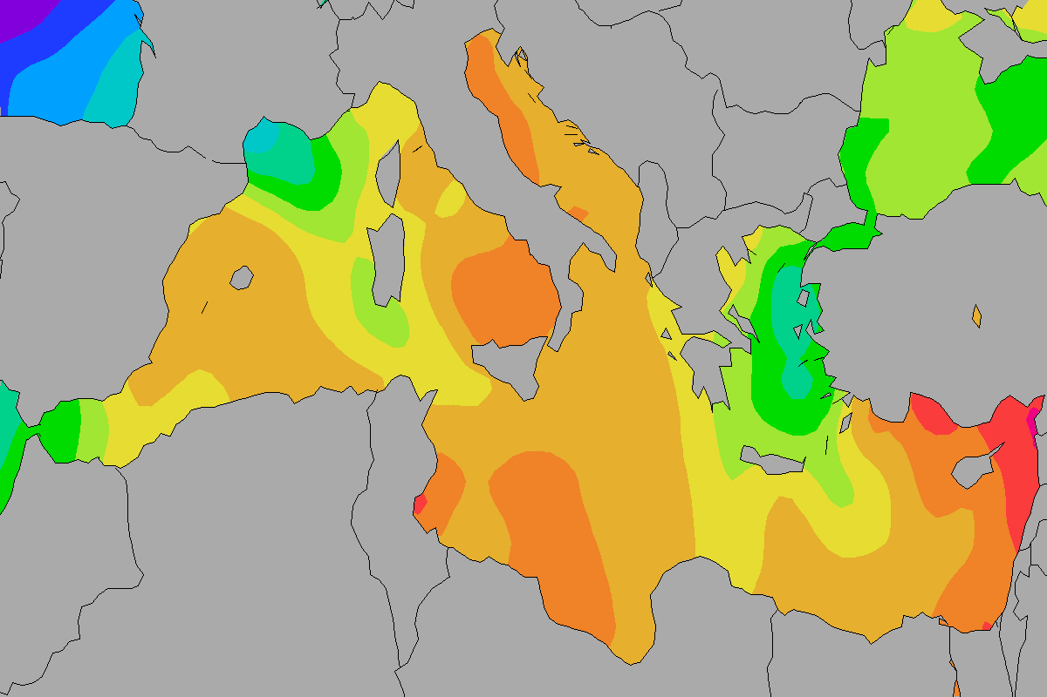
...and has a great aquatic variety
Γι’ αυτό, έχει ποικιλία στο νερό: αλλού πιο κρύο και αλλού πιο ζεστό (και πιο αλμυρό)
In some places the water is cold
In others the water is warmer (and saltier)

Slide 8
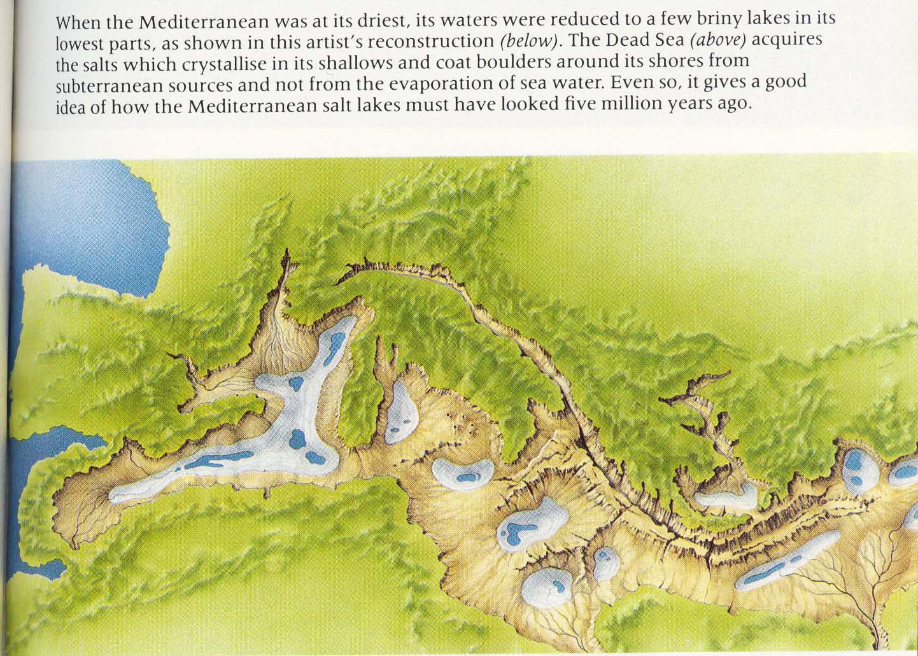
The Mediterranean region has gone through many geological changes
Όταν χωρίστηκε από τον Ατλαντικό, η Μεσόγειος ξεράθηκε για χιλιάδες χρόνια ???
New mountain rages were created
The sea was separated from the Atlantic, dried out and then flooded again
Photo: https://imgur.com/gallery/u7M8y

Slide 9
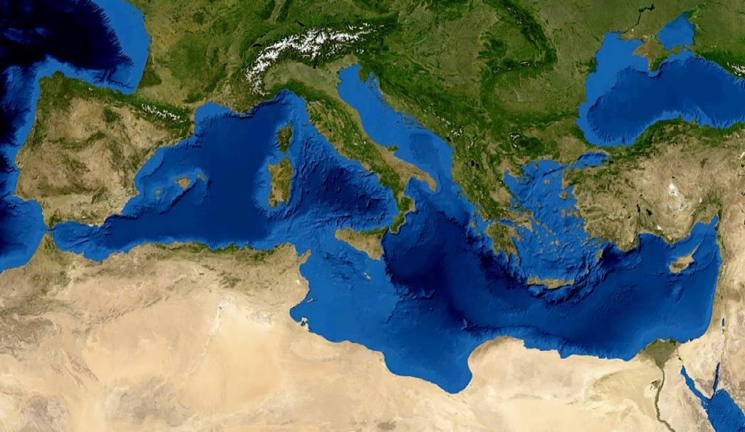
The sea bed and the shores vary
Έχει ποικιλία σε βυθό και ακτές: βαθιές λεκάνες, 12.000 νησιά
12,000 islands
Deep underwater basins
Photo: NASA/Eric Gaba

Slide 10
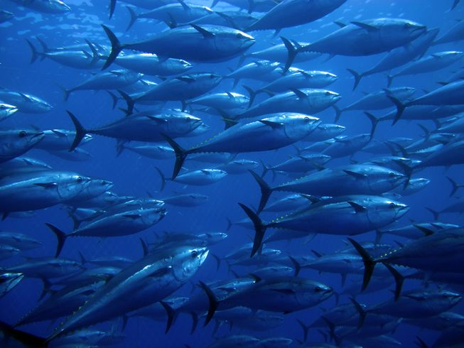
Pelagic zone: large flocks of fish, yet few different species
Πέλαγος: μεγάλα κοπάδια αλλά από λίγα είδη
e.g. tunas
Photo: Ugo Montaldo/Shutterstock
Photo: Ugo Montaldo/Shutterstock

Slide 11
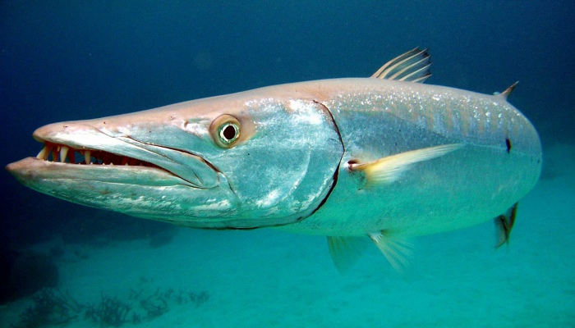
Pelagic zone: where the great predators live (tunas, sharks, whales and dolphins)
Μεγάλοι θηρευτές
Mediterranean barracunda (Sphyraena sphyraena)
Photo: http://www.elmatero.net/texto-diario/mostrar/855953/flora-fauna-dominicana-333-especies-peligro-critico

Slide 12
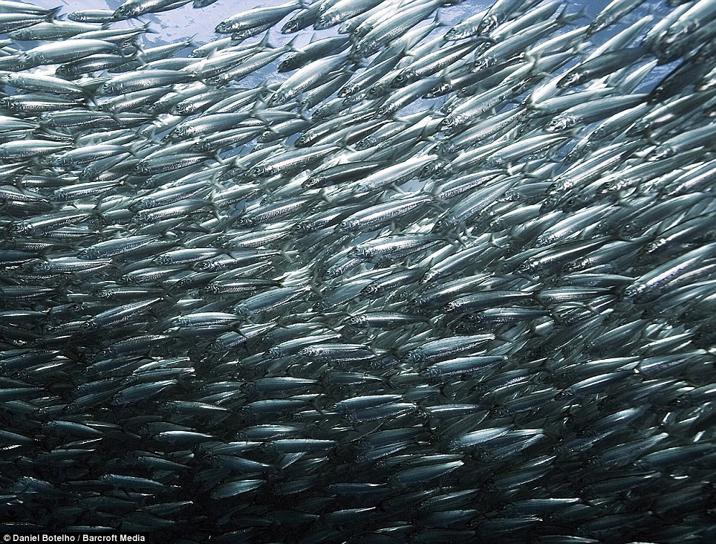
Pelagic zonepelagos: small fish live in large flocks
…κυνηγούν μικρά ψάρια…
Sardines
(European pilchard)
Photo: Daniel Botelho/Barcroft Media

Slide 13
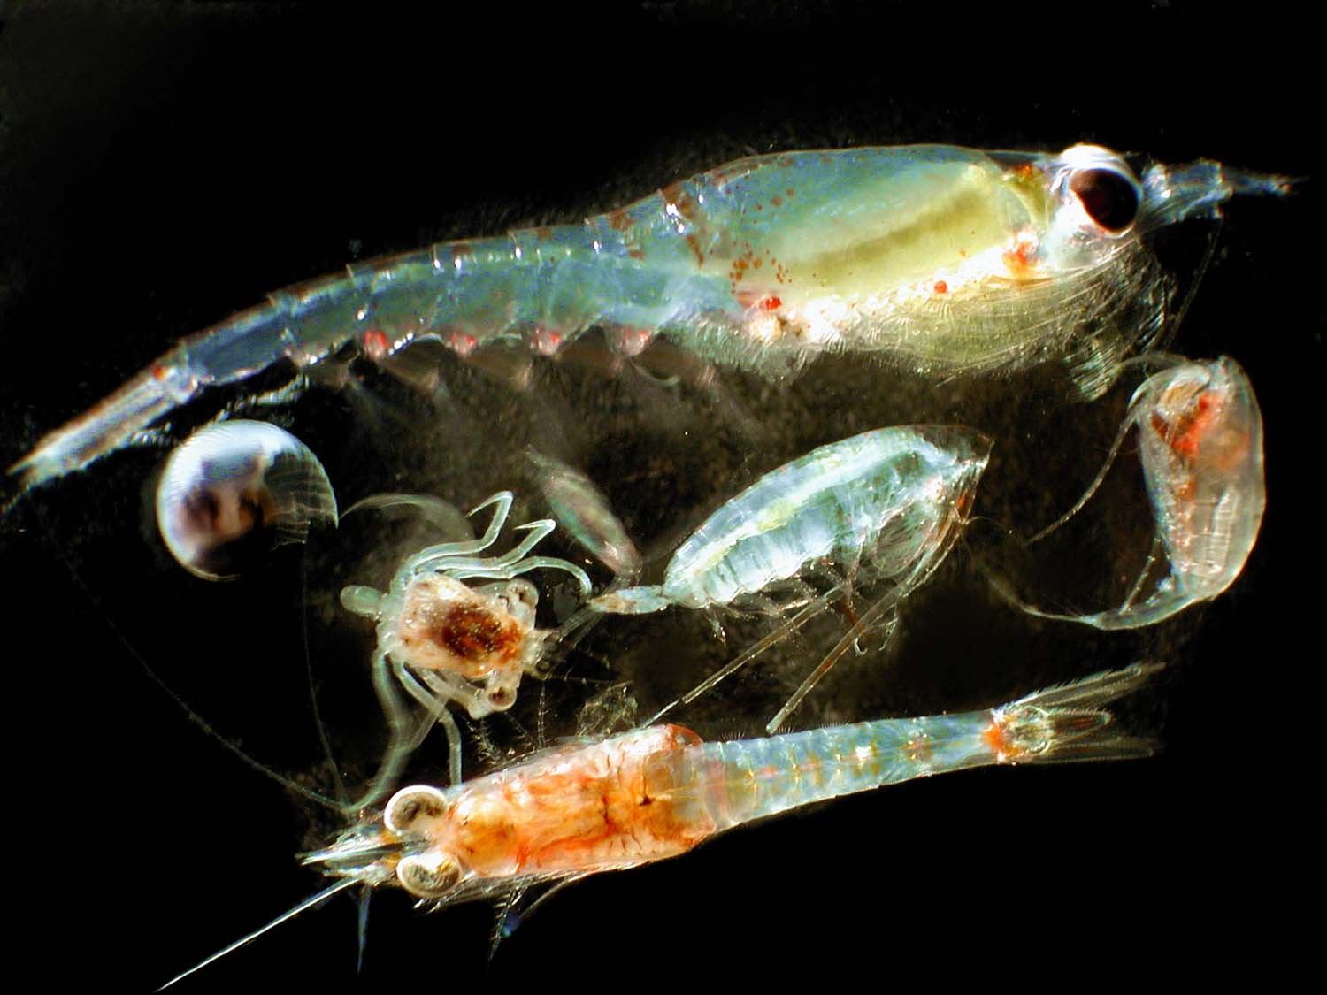
Pelagic zone: small fish feed on zooplankton
…που τρώνε ζωοπλαγκτόν…
crab larva
shrimp larva

Slide 14
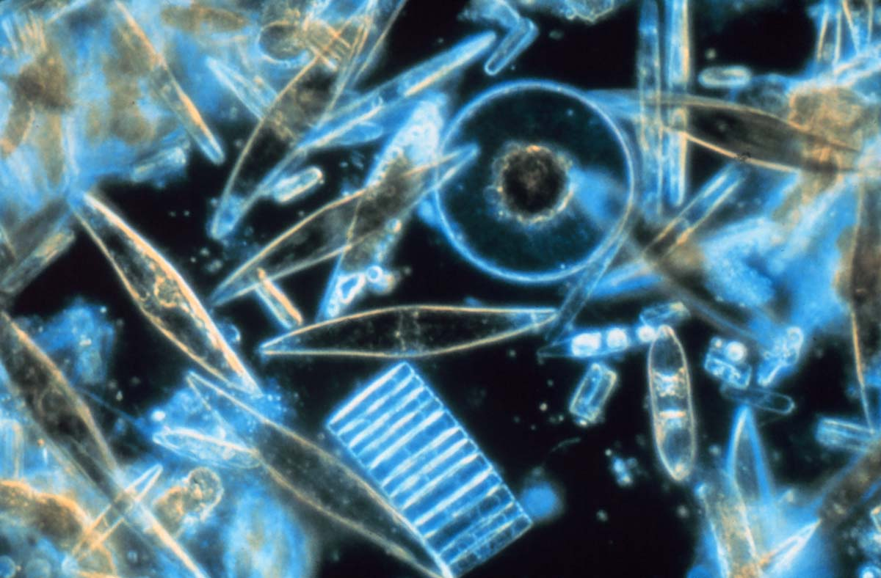
Pelagic zone: zooplankton feeds on phytoplankton (microscopic plants)
…που τρώει φυτοπλαγκτόν, τα φυτά της θάλασσας
Photo: Prof. Gordon T. Taylor, Stony Brook University

Slide 15
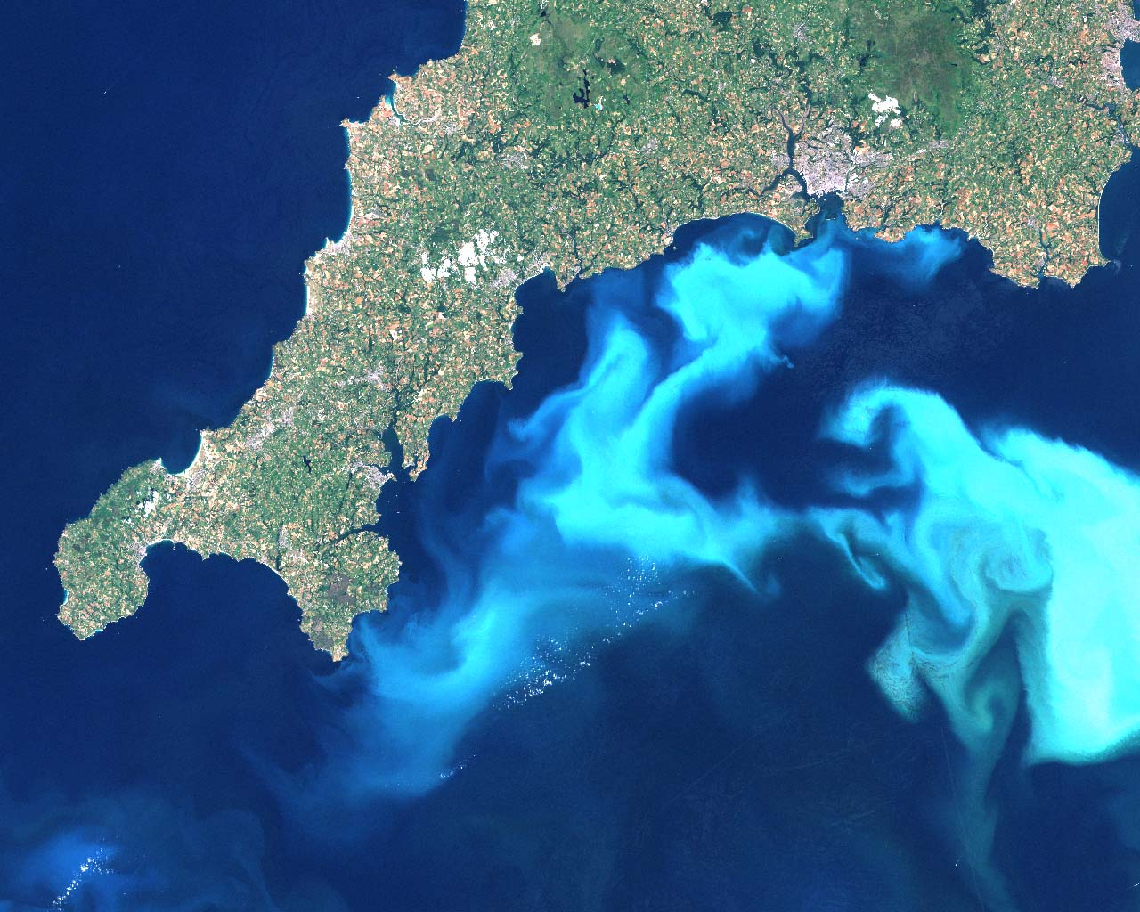
Pelagic zone: plankton are abundant in some seas
Το πλαγκτόν μπορεί να είναι πολύ άφθονο σε κάποιες θάλασσες…
dense plankton
Photo: Steve Groom/NERC EO Data Acquisition and Analysis Service Plymouth

Slide 16
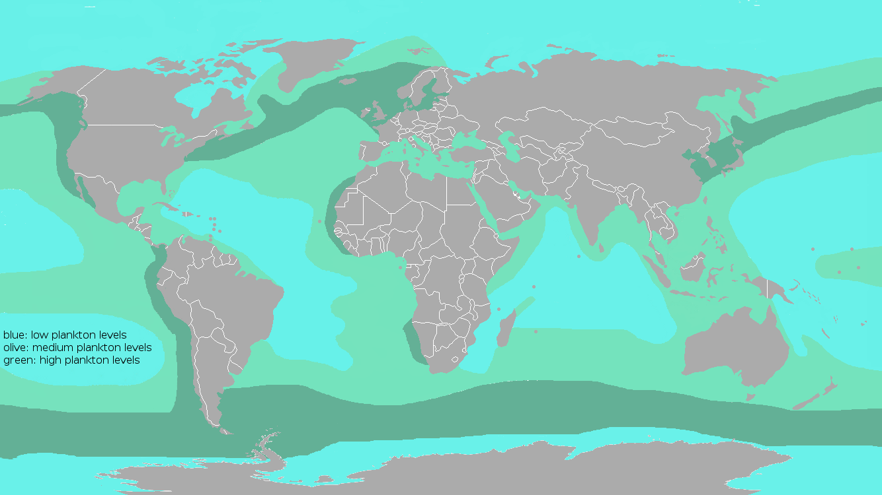
...but not all seas have are rich in plankton
North Sea: large amounts of plankton
…αλλά η Μεσόγειος είναι από τις φτωχές σε πλαγκτόν
Mediterranean Sea: small amounts of plankton
Source: KVDP/Wikipedia

Slide 17
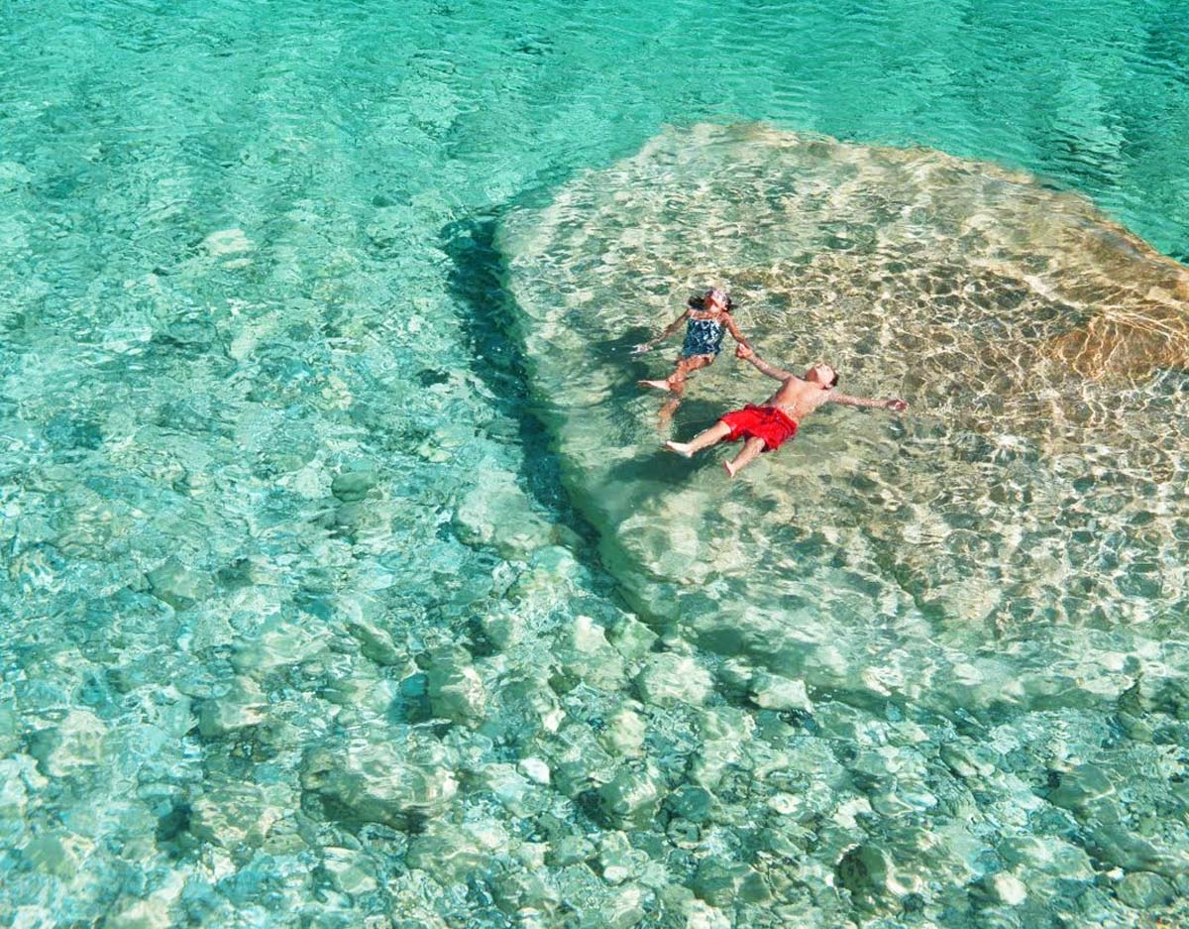
Small amounts of plankton = clear waters in the Mediterranean
Γι’ αυτό έχει διάφανα νερά με λίγα ψάρια
...and few fish

Slide 18
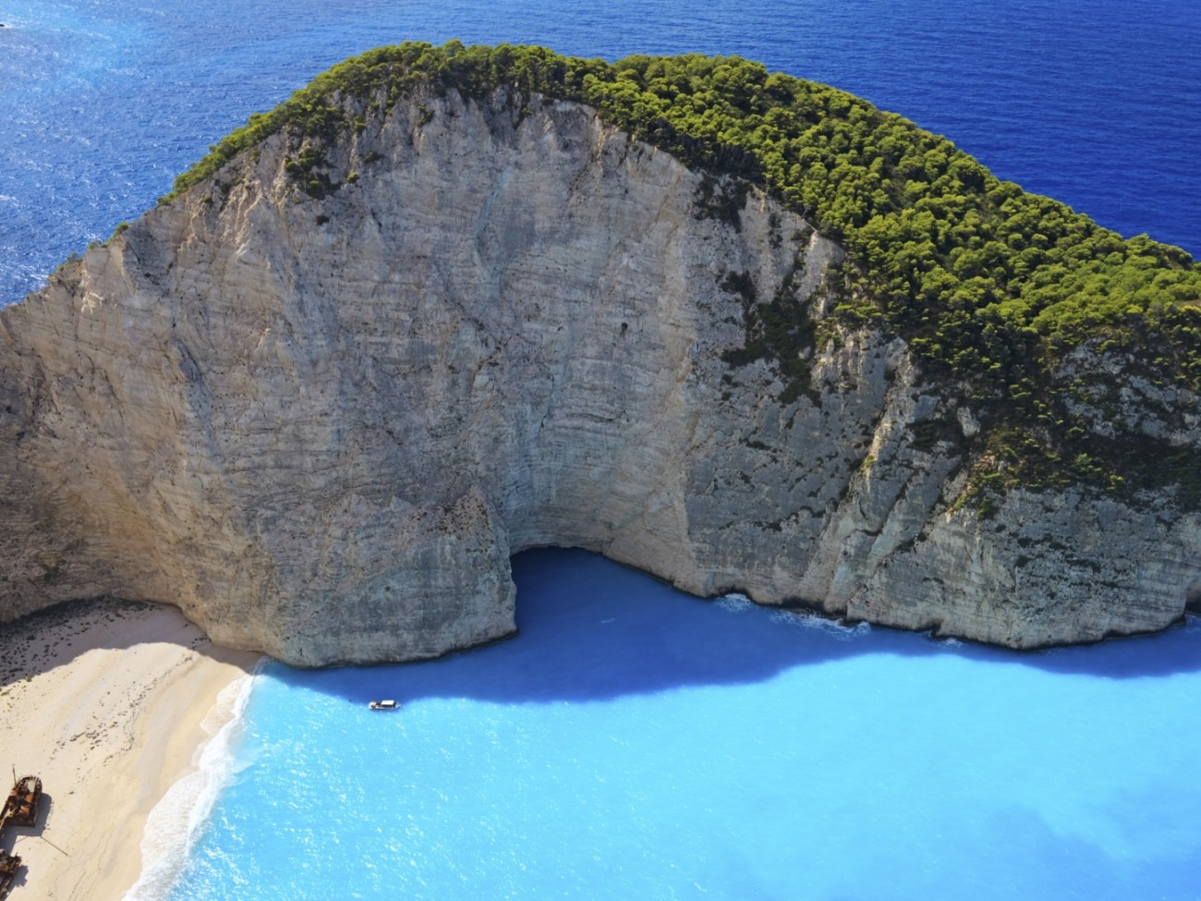
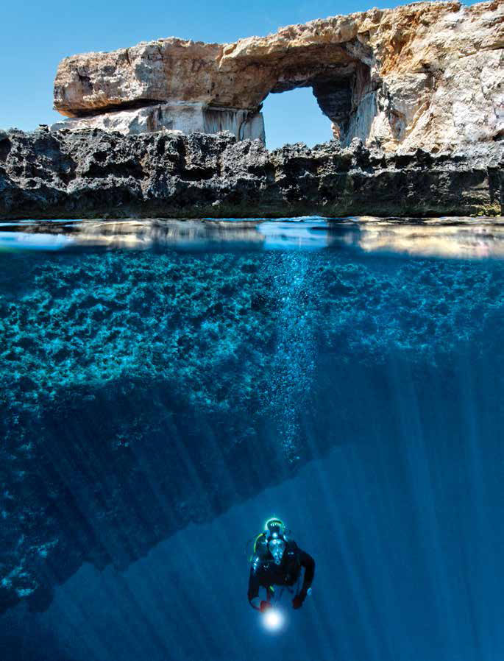
Rocky shores: provide hiding places for many different animals
Βραχώδεις ακτές: πολλές κρυψώνες, πολλά διαφορετικά ζώα
...in the land
...and in the sea
Photo: Tobias Friedrich

Slide 19
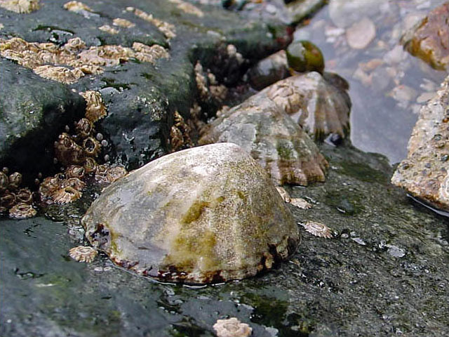
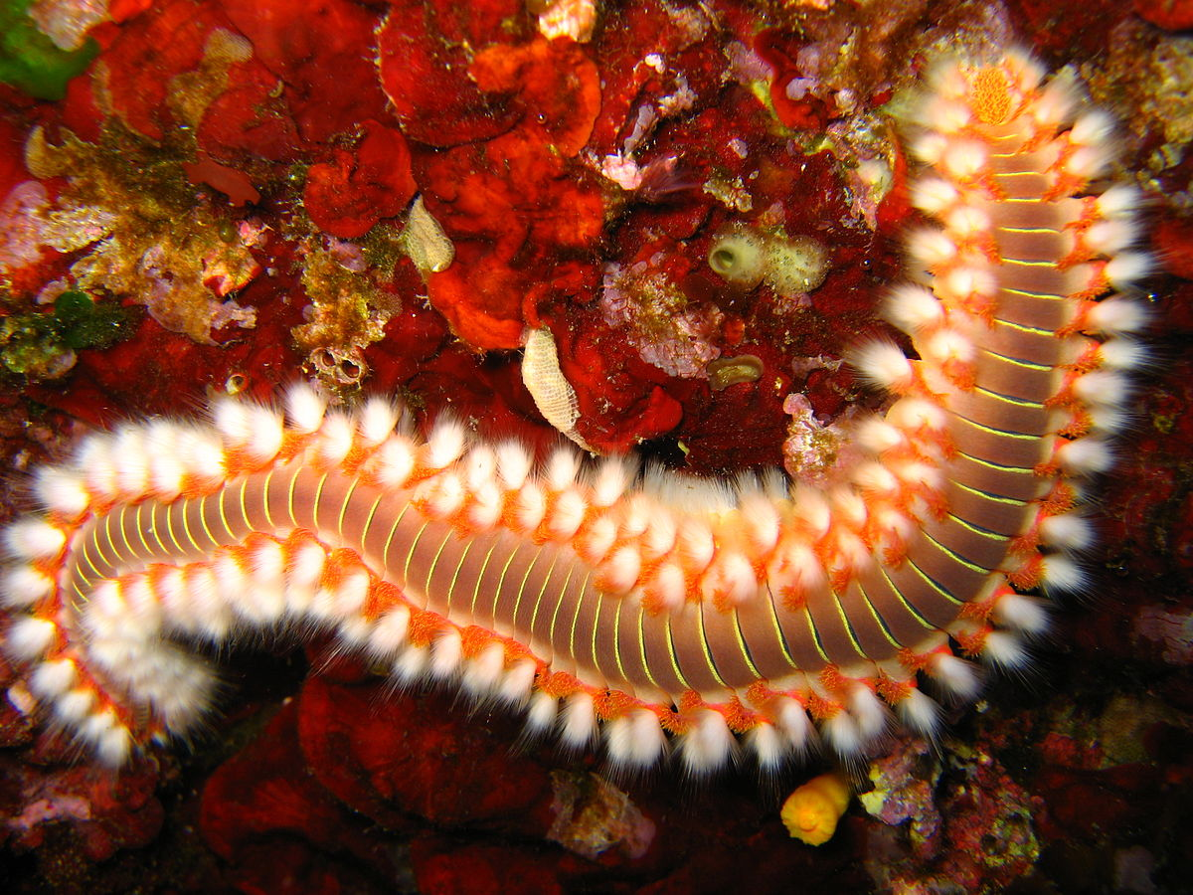
Rocky shores: ...many different invertebrates
…ασπόνδυλα
scolopendra
limpets
Source: http://www.seawater.no/fauna/mollusca/vulgata.html

Slide 20
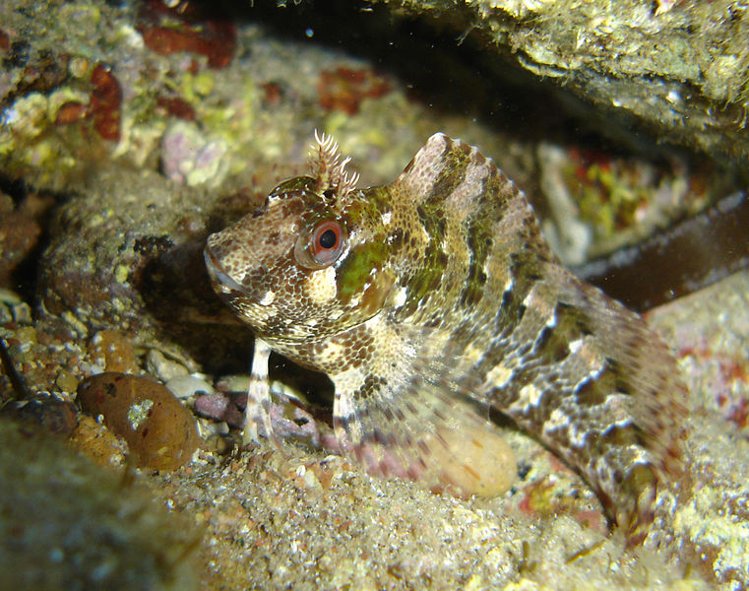
Rocky shores: ... many small fish
…μικρά ψάρια…
e.g. blenny
Photo: Frédéric Pointel

Slide 21
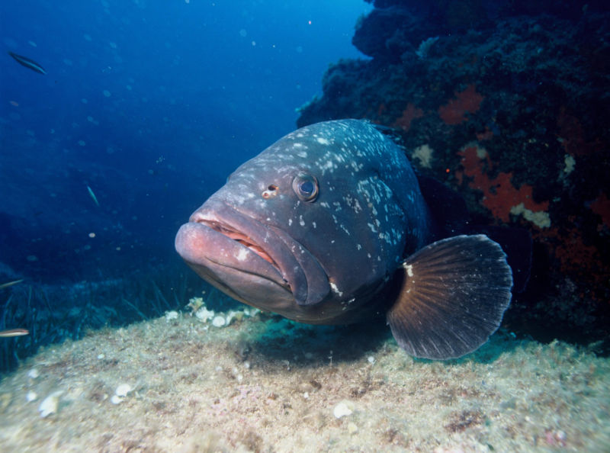
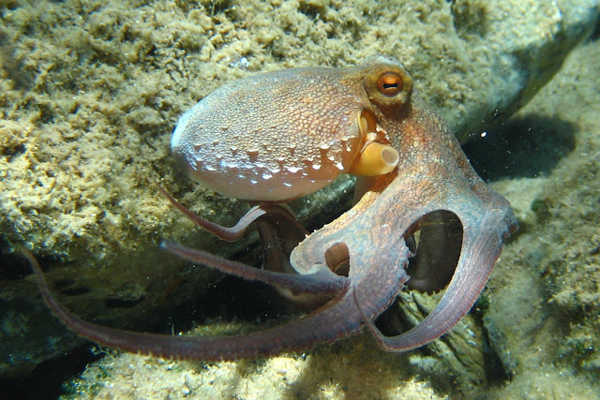
Rocky shores: ...many predators
…αρπακτικά
Invertebrates, e.g. octopus
Fish, e.g. dusky grouper
Photo: Beckmannjan/GFDL
Photo: Albert Kok

Slide 22
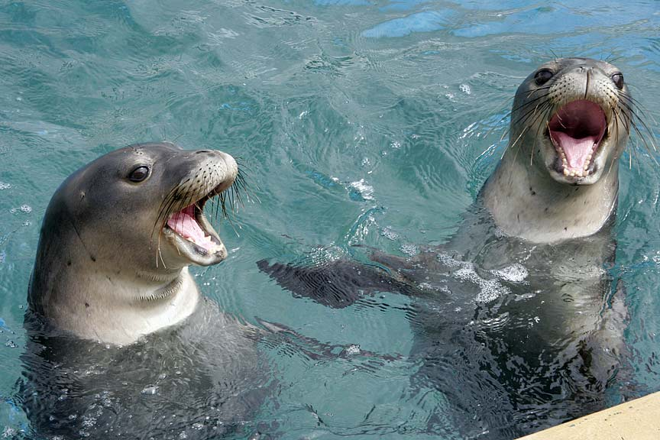
Mammals, e.g. seals
Φώκια στις σπηλιές
Source: https://flowvella.com/s/11vc/Hawaiian-Monk-Seal

Slide 23
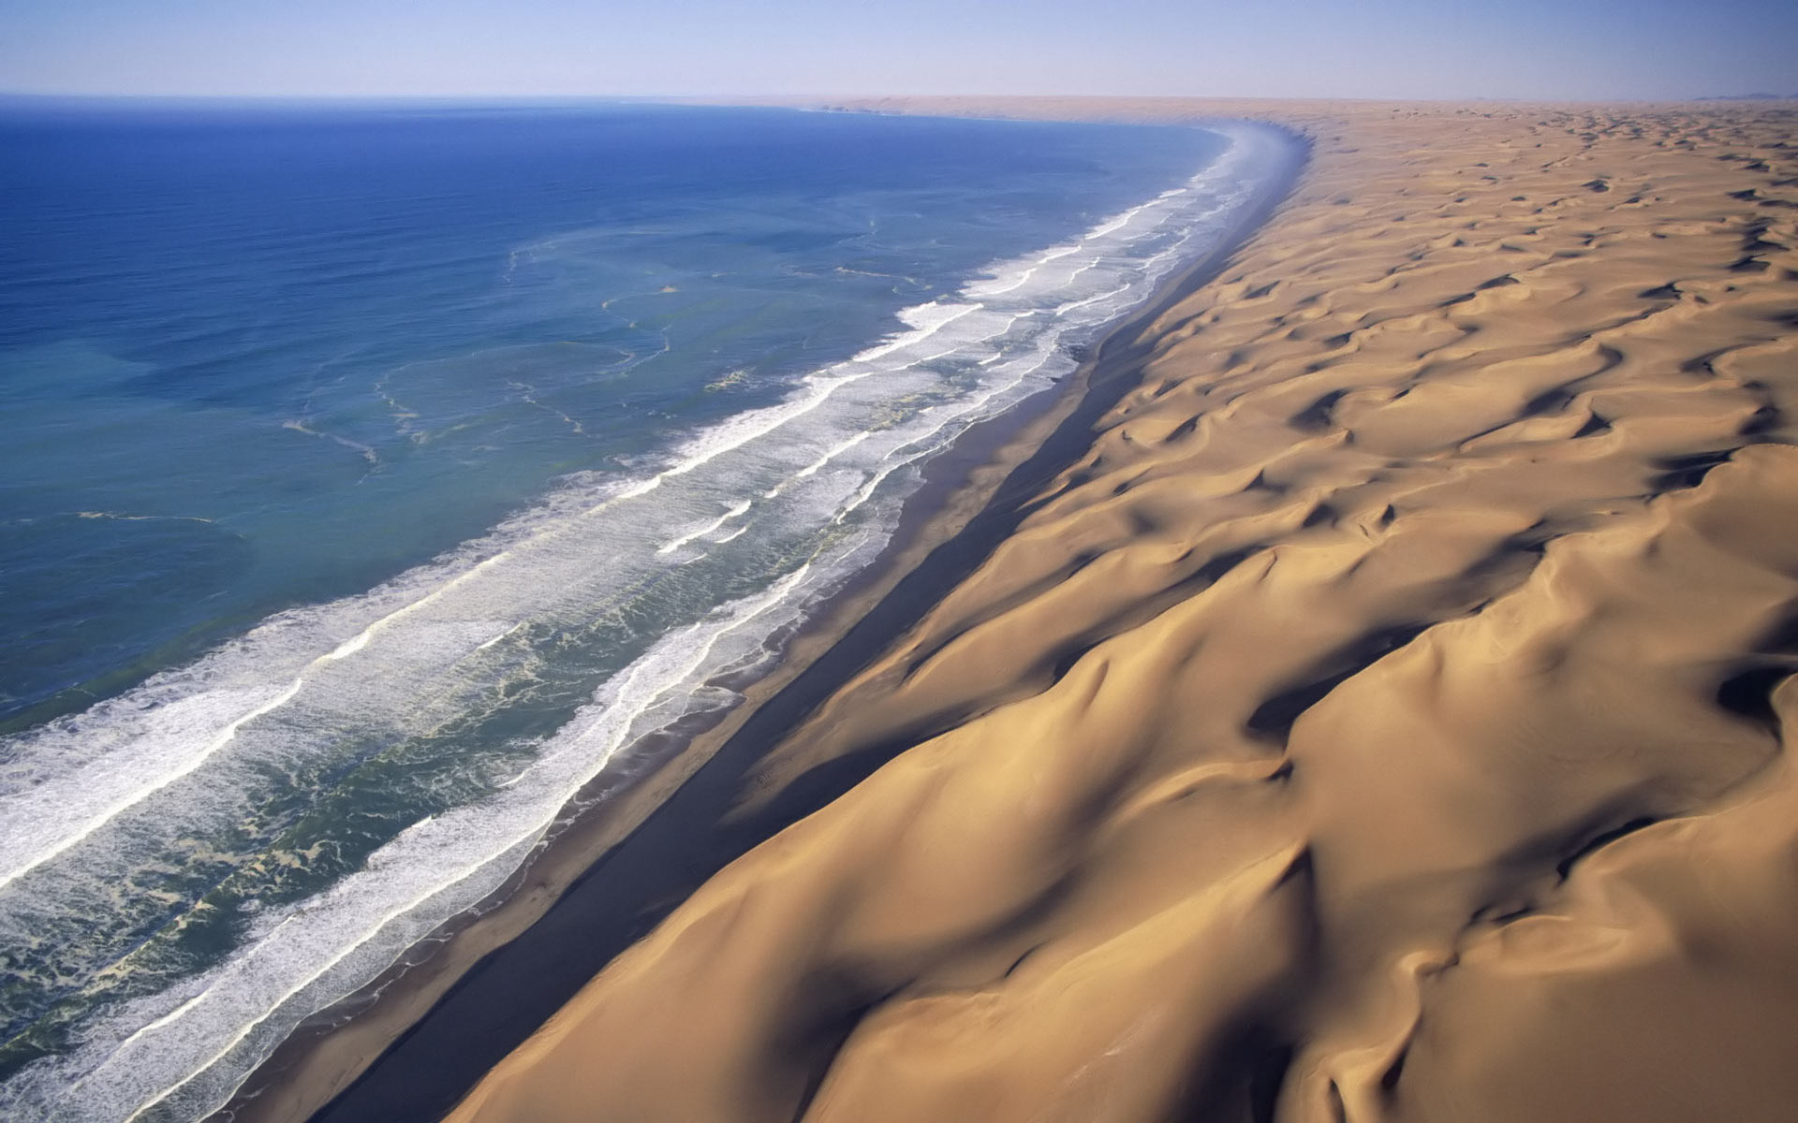
Sandy beaches: sand is constantly moving
Αμμώδεις παραλίες: μετακινούμενη άμμος
The waves bring in new sand
The wind pushes the sand towards the land
Source: http://libguides.northwestern.edu/c.php?g=319610&p=2136014

Slide 24
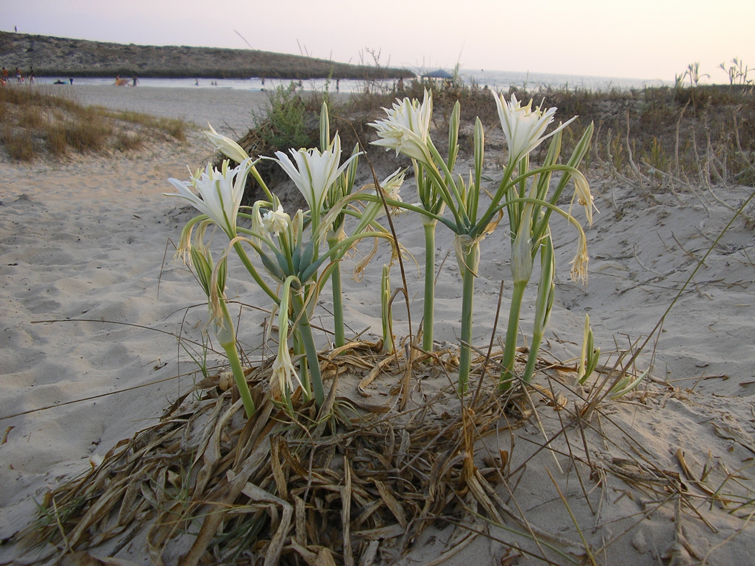
Sandy beaches: plant roots hold the sand in place
…αμμόφιλα φυτά σταθεροποιούν την άμμο
sea daffodil
Photo: Zvika

Slide 25
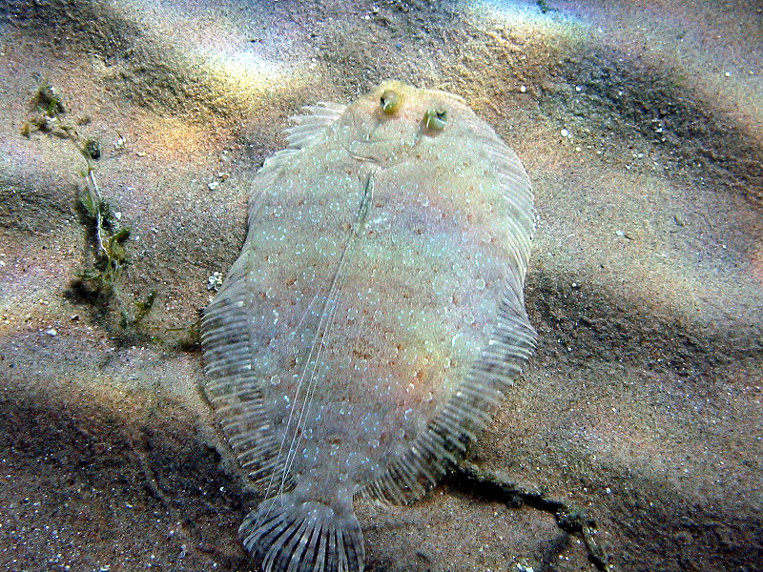
Sandy beaches: animals are hiding in the sand
…ζώα κρύβονται στην άμμο
Soles imitate the color of the sand
Photo: Photo2222/Wikipedia

Slide 26
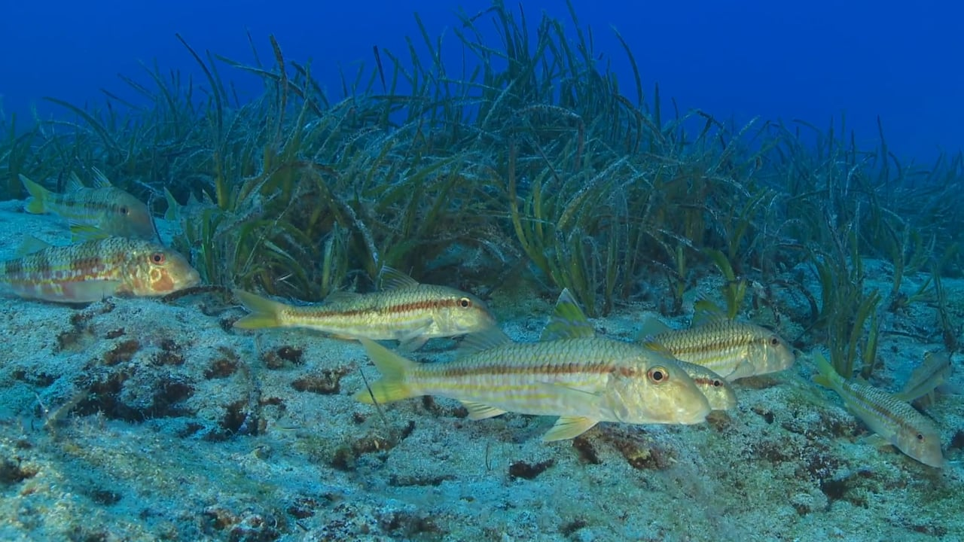
Posidonia meadows: valuable shelter for small animals
Λιβάδια Ποσειδωνίας είναι πολύτιμο καταφύγιο μικρών ζώων
Posidonia: a sea plant that grows only in the Mediterranean Sea

Slide 27
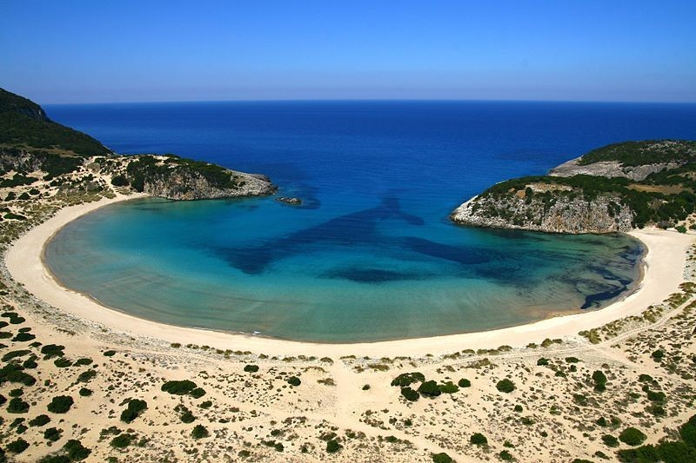
Sandy beaches: host their own unique wildlife
Οι ήσυχες παραλίες έχουν τη δική τους άγρια ζωή
In the posidonia meadow: juvenile fish
In the sand: turtle nests
In the bushes: many insects

Slide 28
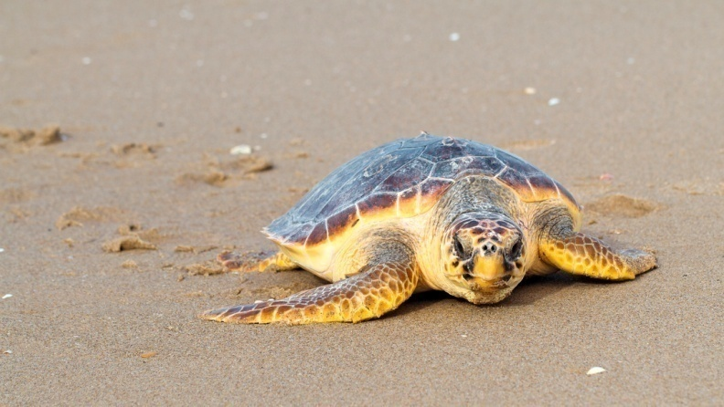
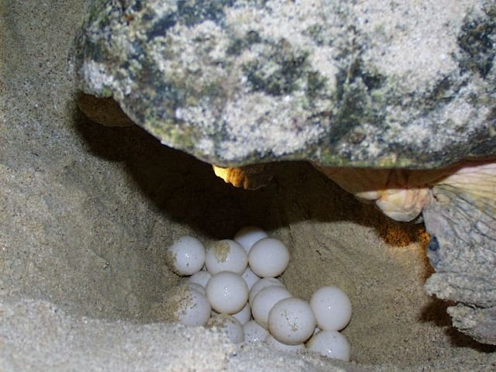
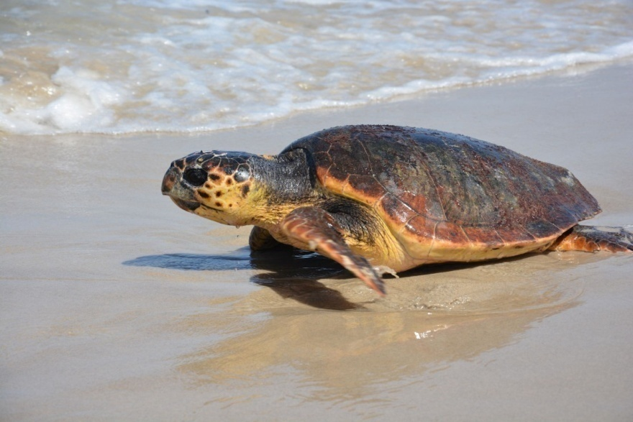
Sandy beaches: where the sea turtles lay their eggs
Οι χελώνες γεννούν σε παραλίες

Slide 29
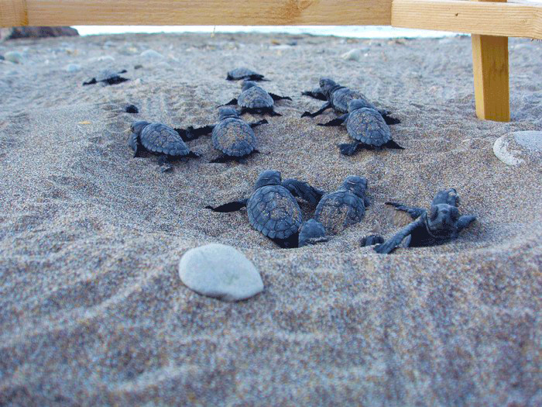
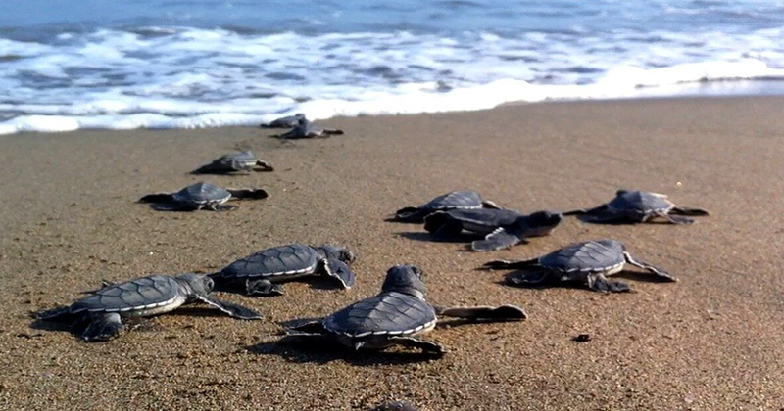
Sandy beaches: almost 100 hatchlings come out from each nest…
Νεογέννητα χελωνάκια επιστρέφουν στη θάλασσα
...and head to the sea

Slide 30
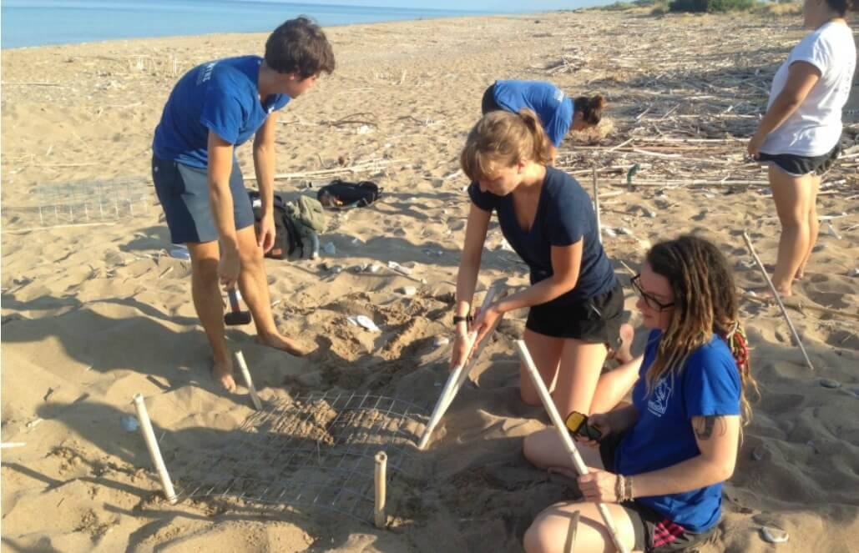
ARCHELON volunteers protect the nests from humans and predators
επιστήμονες προστατεύουν φωλιές από λουόμενους και θηρευτές
Mesh prevents foxes from digging
Sticks mark the nests so people avoid placing beach umbrellas
© ARCHELON

Slide 31
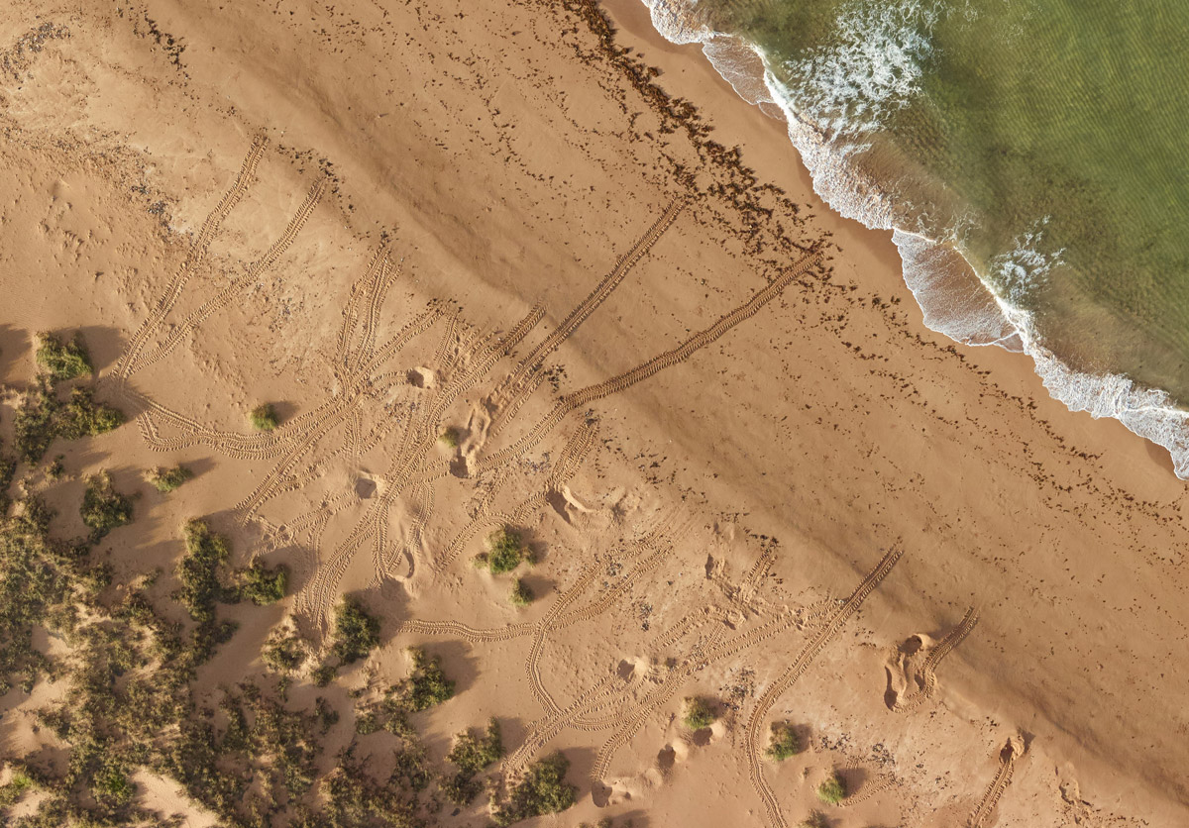
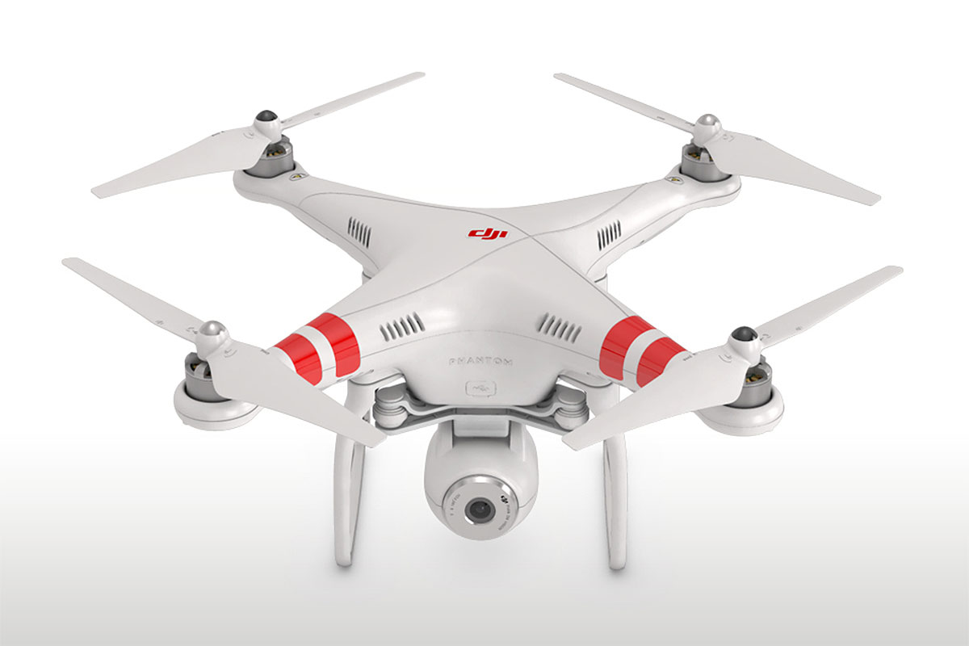
The scientists document the nests using camera drones
καταμετρούν με drone τις φωλιές
Camera drone
Turtle tracks

Slide 32
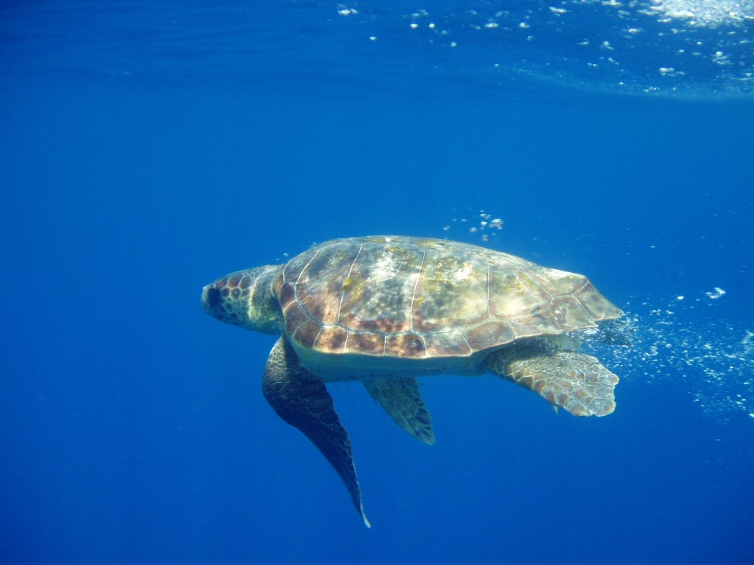
Each turtle travels the sea for decades
Χελώνες ταξιδεύουν χρόνια στη θάλασσα

Slide 33
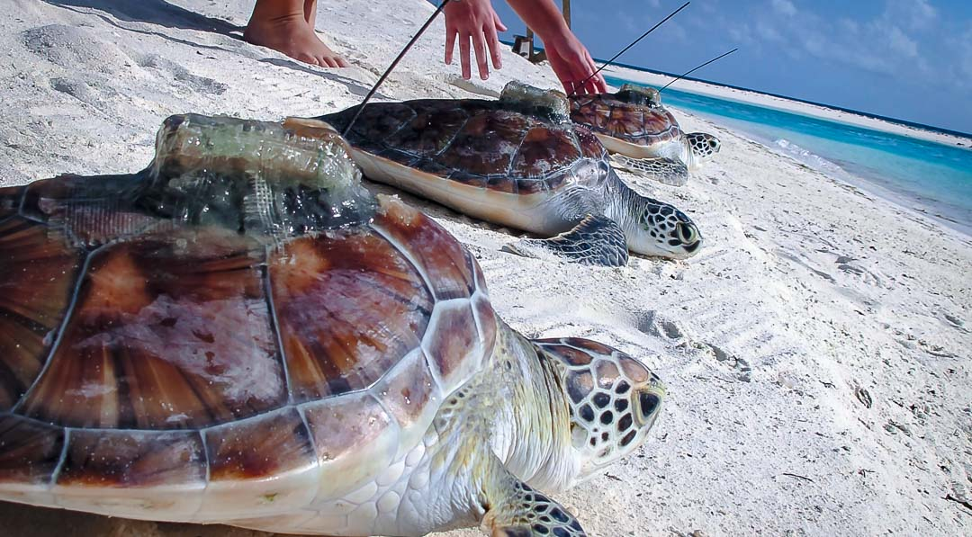
Scientists are motoring the turtles with satellite transmitters
Παρακολουθούν τις χελώνες με δορυφορικούς πομπούς
Transmitter attached to the carapace
Source: http://marinesavers.com/turtle-conservation/

Slide 34
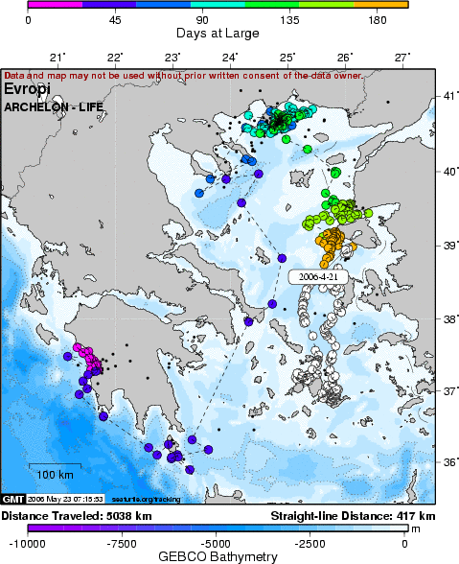
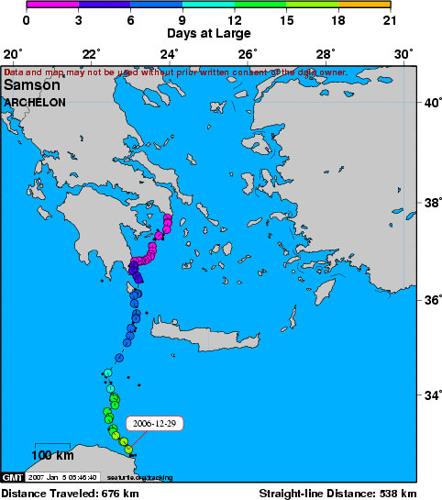
... and discover their routes
Turtle born in the Kyparissia bay
Turtle released by the Sea Turtle Rescue Centre
…και μαθαίνουν τις διαδρομές τους

Slide 35
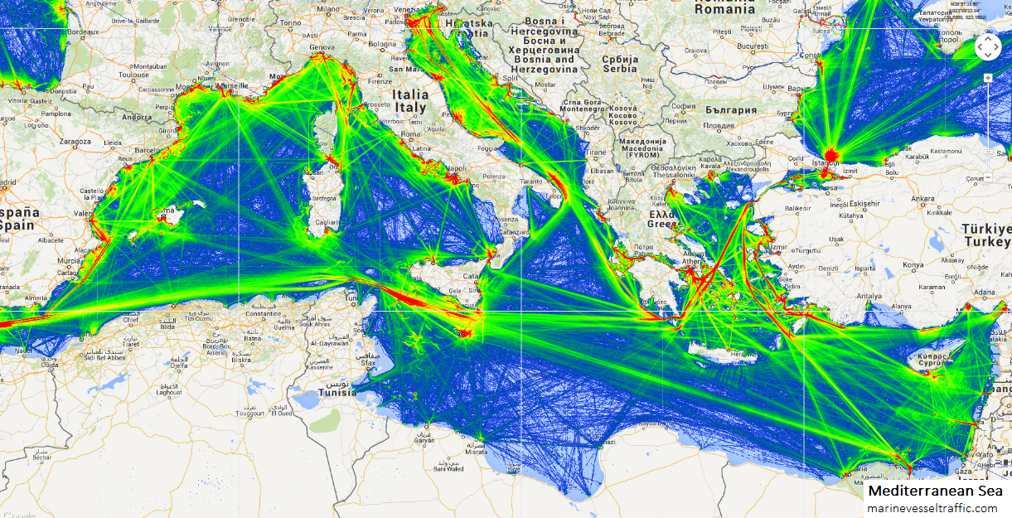
Unfortunately, the Mediterranean Sea is constantly crossed by many ships
Όμως, η Μεσόγειος έχει διαδρομές
με πολλά πλοία

Slide 36
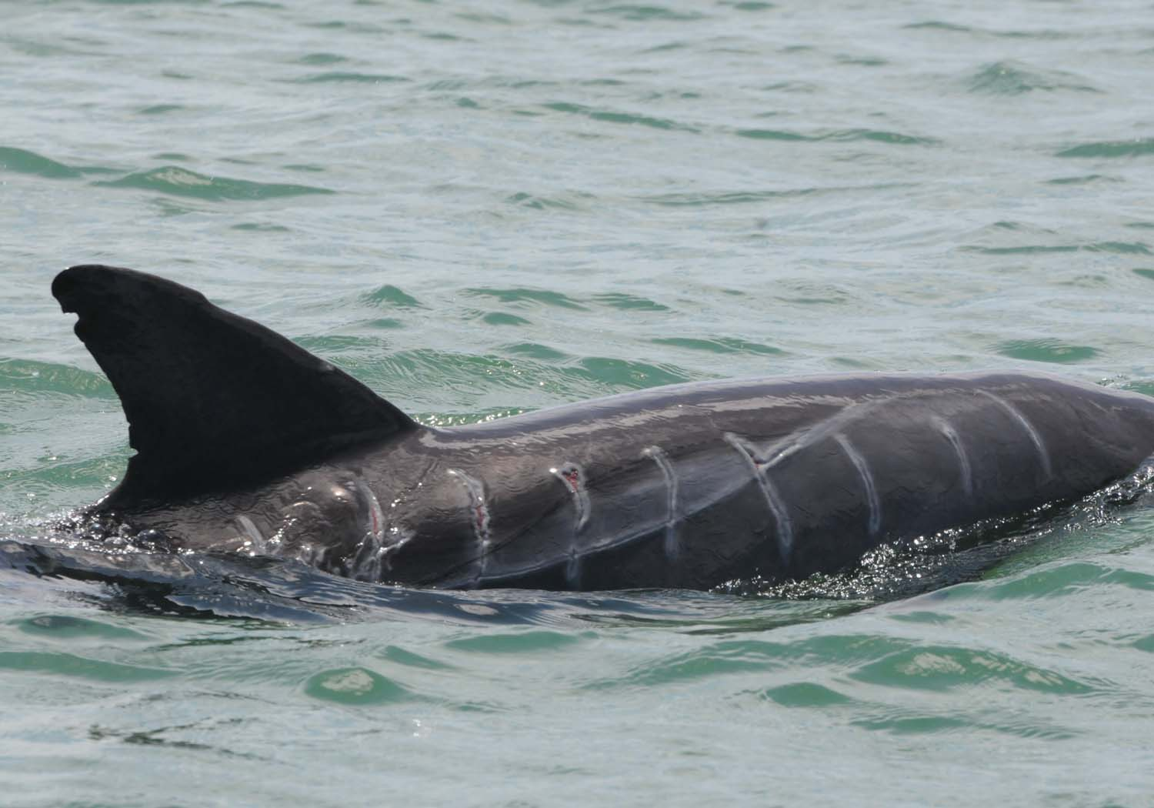
Marine animals are threatened by the propellers of big and small ships
Όλα τα θαλάσσια ζώα κινδυνεύουν από τους έλικες
Distinctive wounds caused by propellers

Slide 37
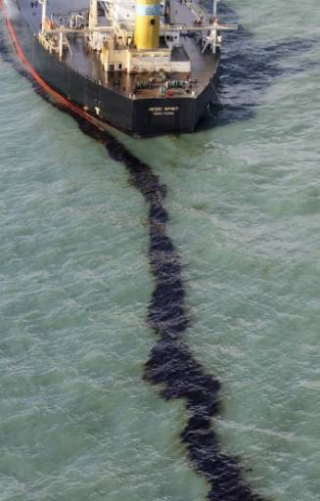
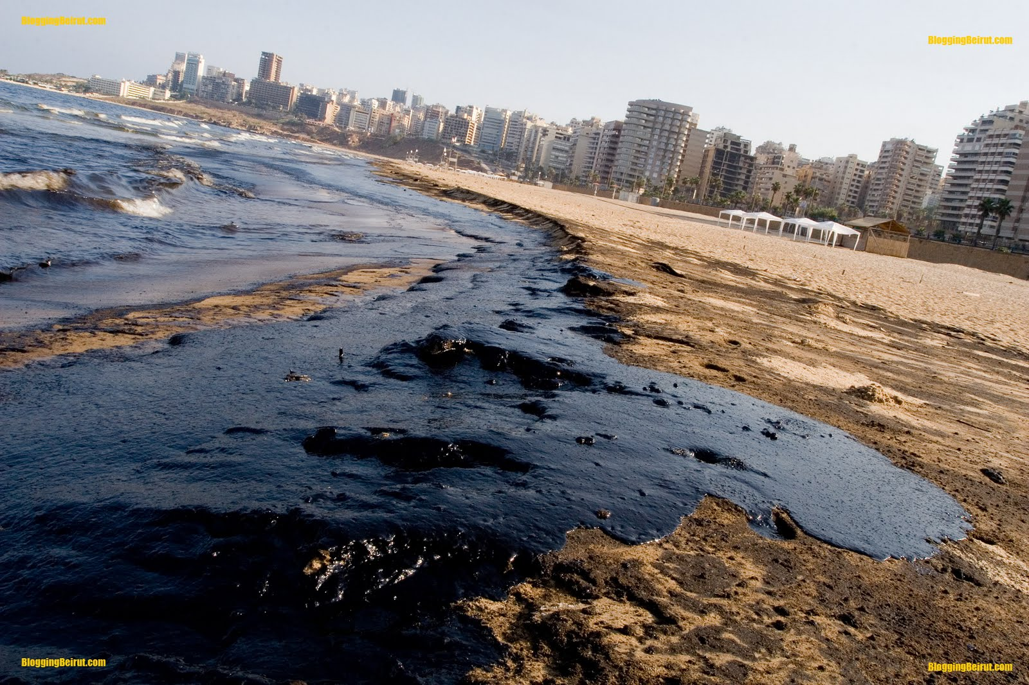
...are endangered by pollution
…από τη ρύπανση
Photo: Yun Seok-ee/AP

Slide 38
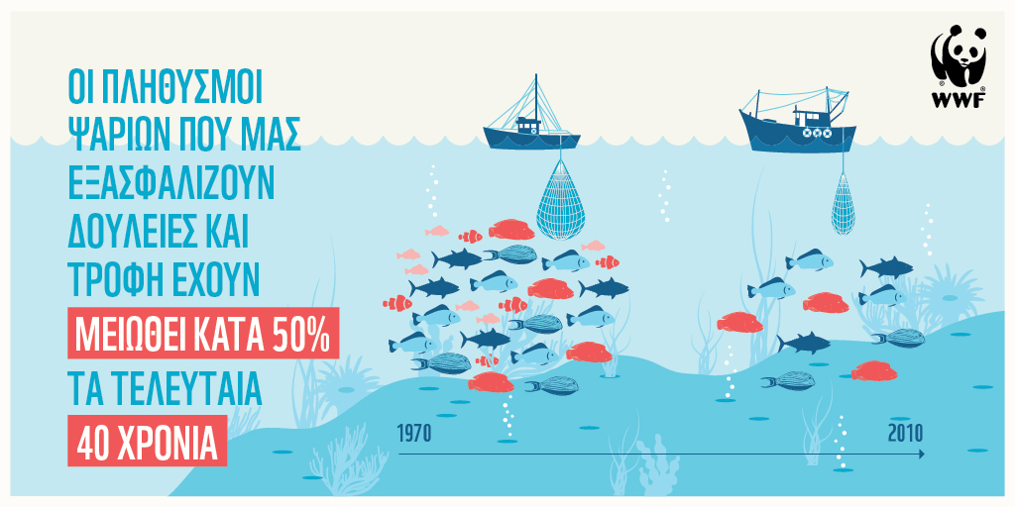
...are threatened by overfishing
…από το υπερβολικό ψάρεμα
https://www.zoosos.gr/ereuna-apokaluptei-50-tis-thalassias-zois-exei-eksafanistei/

Slide 39
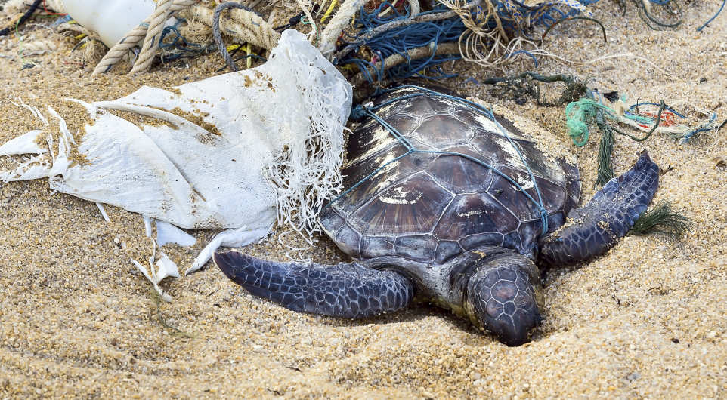
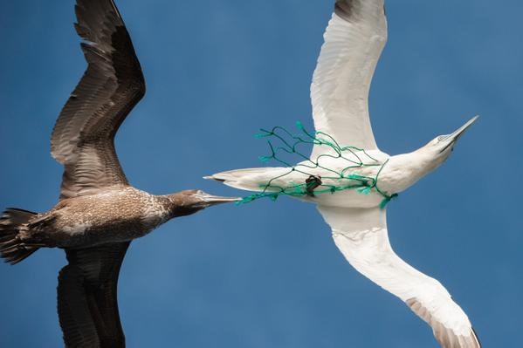
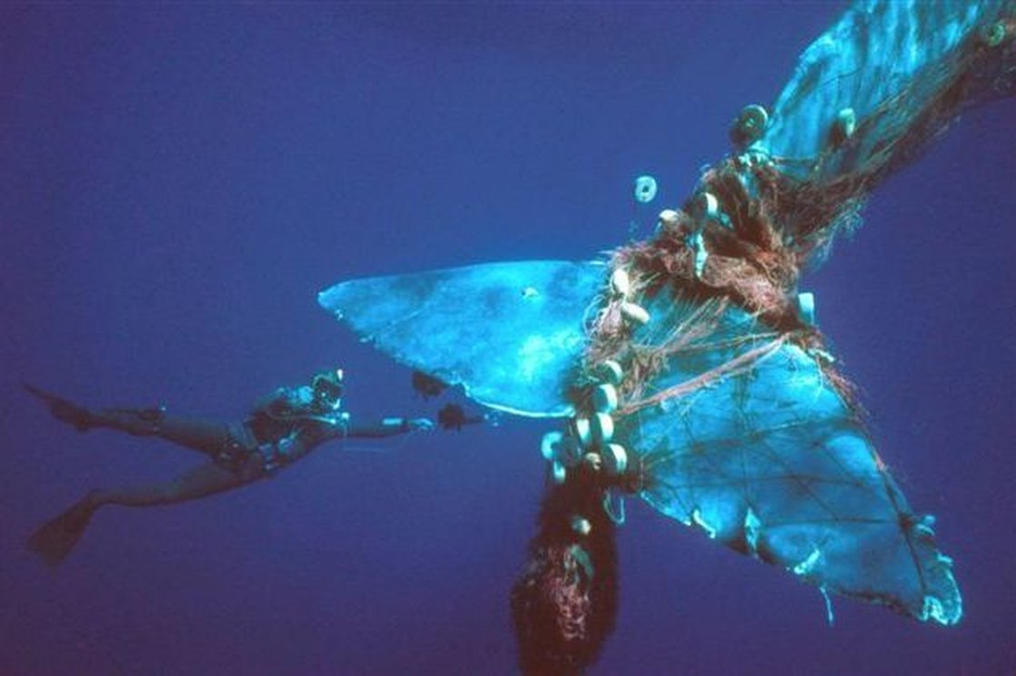

Photo: Pierre GLEIZES, REA/Redux
…από τα δίχτυα
...are threatened by fishing nets
Photo: Alberto Romeo/Marine Photobank

Slide 40



Photo Courtesy NOAA
…are endangered by plastics
…από τα πλαστικά
Photo: Tom Grundy

Slide 41

...are endangered by cans
…από τις κονσέρβες
Photo: Brenda Becker/NOAA

Slide 42

Sea turtles are losing their nesting beaches
Οι χελώνες χάνουν τις παραλίες τους από τη δόμηση και τα φώτα
Light makes it hard for turtles to orientate
Umbrellas block their passage

Slide 43


Solutions do exist: proper lighting on the beaches
Wrong lighting blind the turtles
Λύσεις υπάρχουν: ειδικά φώτα στις παραλίες
Correct lighting illuminate only where it is needed

Slide 44

http://www.eurocean.org/np4/493.html
Solutions do exist: Protected coastal and marine areas
…προστατευόμενες θαλάσσιες περιοχές
They seem to be numerous but the Meditterenean Sea is large

Slide 45

Solutions do exist: Protected marine areas
…που τροφοδοτούν με ψάρια τις γειτονικές θάλασσες
Each protected area supplies with fish the neighboring sea

Slide 46

Solutions do exist: fishing under limits
…ψάρεμα με μέτρο (πιο πολλά ψάρια, πιο λίγες τσούχτρες)
Overfishing reduces the number of fish, yet allow jellyfish to multiply
Photo from YouTube footage: mikeyk730

Slide 47

Solutions do exist: Nets with special exit for the turtles
«έξοδος κινδύνου» για χελώνες στα δίχτυα
The bag-like net of a trawler collects the fish
... yet the turtles come out from a special hatch
Richard Bornemann/WWF-US

Slide 48

Solutions do exist: Recycling of trash
…ανακύκλωση πλαστικών
This way plastic waste ending up in the sea will be decreased

Slide 49

Solutions do exist: Tourism under limits
Less destruction of the shores
Less disturbance for the turtles
© ARCHELON

Slide 50

We are together in the Mediterranean Sea
...neither can I
Είμαστε μαζί στη Μεσόγειο: αν δεν μπορέσουν οι χελώνες να ζήσουν ούτε εμείς θα μπορέσουμε
If I cannot survive...

Slide 51

This photographic presentation accompanies the educational package entitled "With the turtles in the sea" from the project LIFE EUROTURTLES
All images come from the web or are property of ARCHELON. Not intended for use other than this presentation without reference to the LIFE EUROTURTLES project, the image source and a permission.
Environmental interpretation: Vassilis Hatzirvassanis

Slide 52



Collective actions for the improvement of measures taken for the conservation of the sea turtles population (LIFE15NAT/HR/000997). The project is under the financing LIFE program of the European Union / info@euroturtles.eu
This presentation accompanies the educational package entitled "With the turtles in the sea" from the project LIFE EUROTURTLES (LIFE15NAT/HR/000997) and has been produced by the contribution of the LIFE financing tool of the EU.
The content does not reflect necessarily the official views of the EU.
ARCHELON - Τhe Sea Turtle Protection Society
http://www.archelon.gr/
ΑΡΧΕΛΩΝ - Σύλλογος για την Προστασία της Θαλάσσιας Χελώνας:
http://www.archelon.gr/

